Slide 1
MobilityFirst
Team 3: It is our belief that the future of the internet is based on the MobilityFirst architecture.

Slide 2
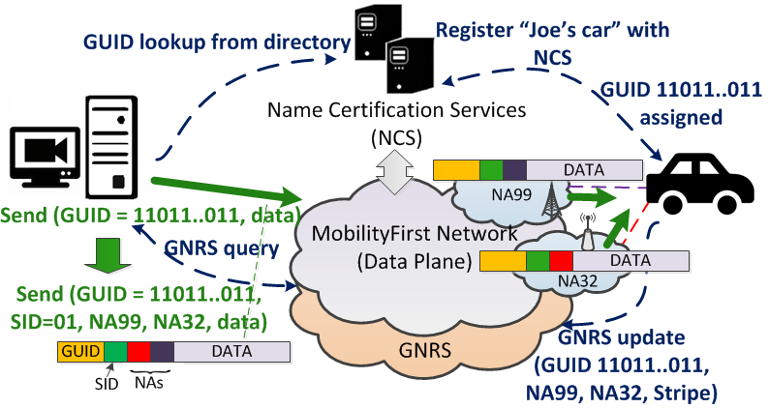
MobilityFirst architecture

Slide 3
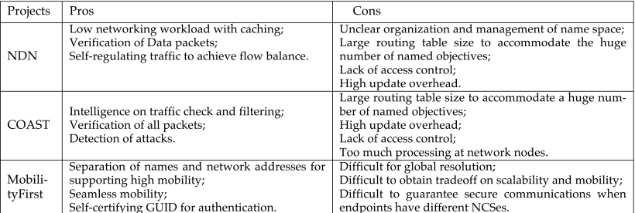
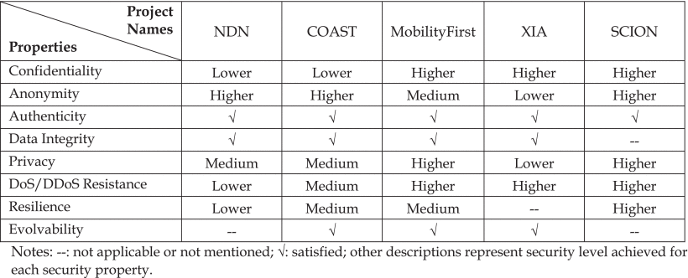

Slide 4
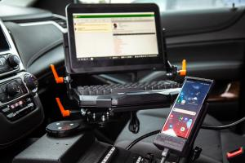
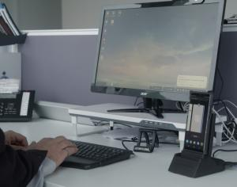
#MobilityFirst: Doing More, With Less
SEP 3, 2019 | FSET INFORMATION TECHNOLOGY
Author: Matthew Bradford
Speed and access to information are critical in times of public need. And as law enforcement agencies seek ways to better protect their communities, many are relying on new and emerging mobile technologies to keep their officers informed and on the move.
FSET incorporated Citrix Workspace providing the members with Windows published desktops and applications on an Android device. Providing officers with the necessary tools to work seamlessly and in real-time with their co-workers in the field
Notes:
http://mediaedgedigital.com/supplierinsights/oacp/mobilityfirst-doing-more-with-less/
FSET incorporated Citrix Workspace providing the members with Windows published desktops and applications on an Android device.

Slide 5
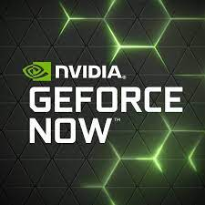
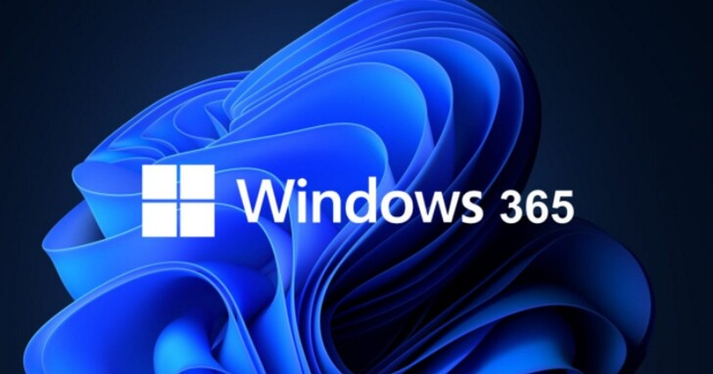
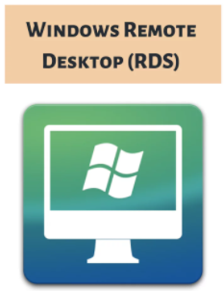
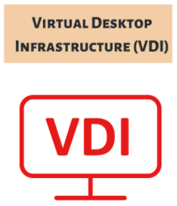
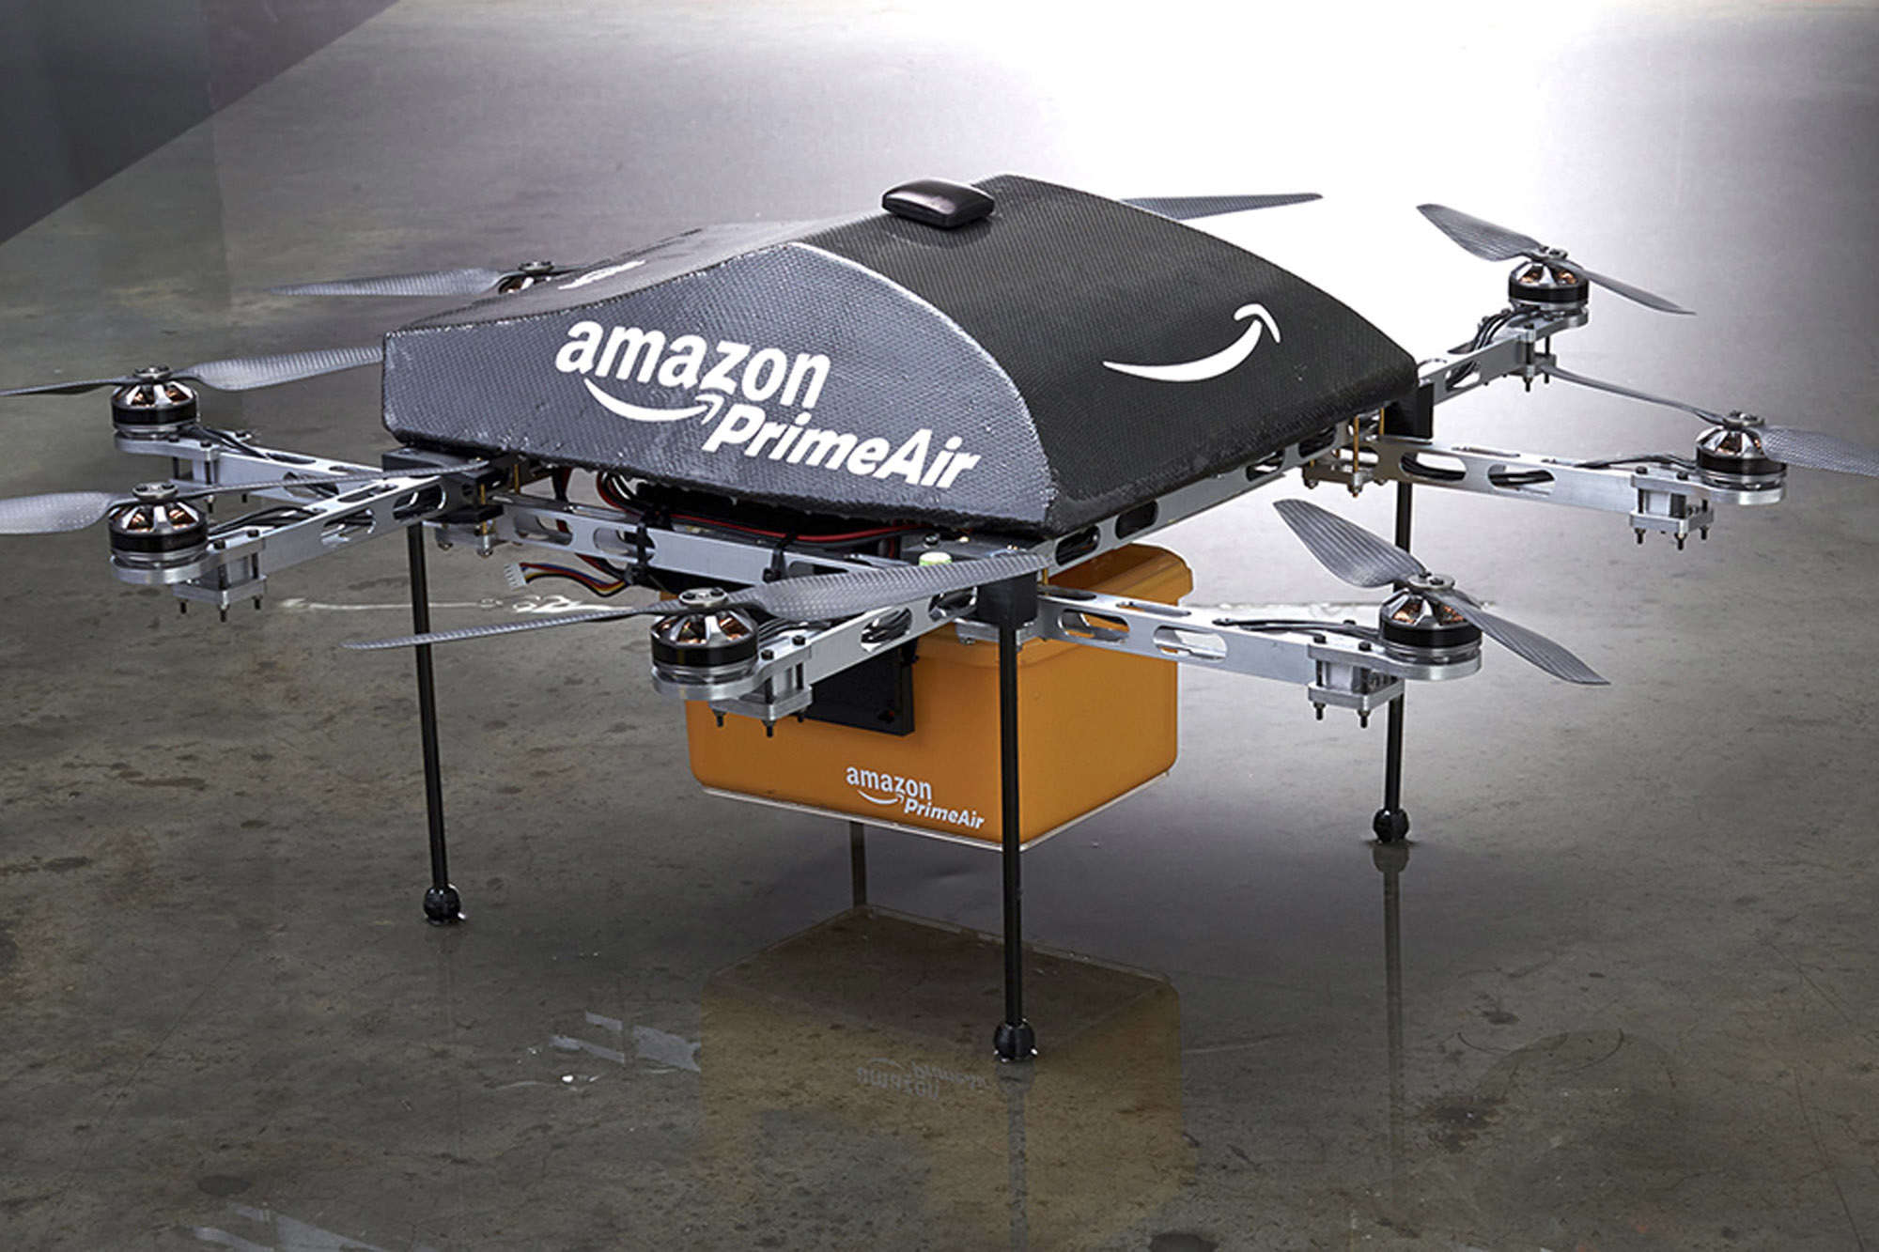
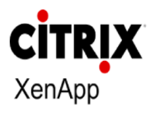
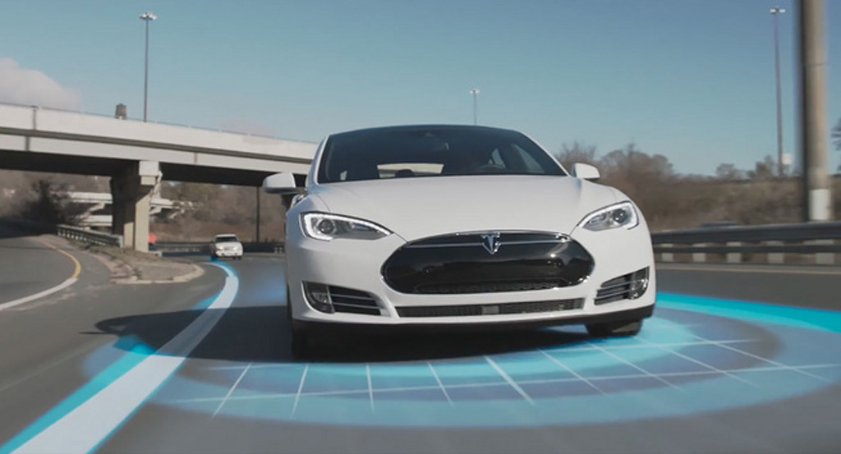
Notes:
https://ideastack.com/blog/virtual-desktop-infrastructure/windows-remote-desktop-rds-vs-virtual-desktop-infrastructure-vdi/
https://www.microsoft.com/zh-hk/windows-365

Slide 6
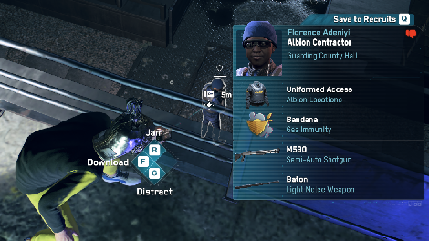

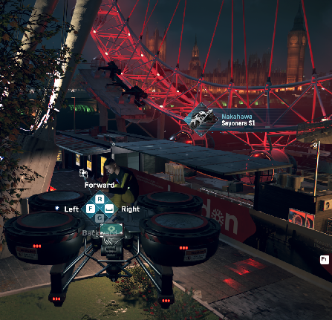
Notes:
Watch Dogs: Legion takes place within a fictionalised representation of London in the "near future".
A genius sociopath, Nigel has his own interesting way of keeping London safe
HACKING IS YOUR WEAPON
Auto drive drone and autopilot vehicle
https://store.ubi.com/sea/game?lang=en_SG&pid=5cec2d5839798c0870c07698&dwvar_5cec2d5839798c0870c07698_Platform=pcdl&edition=Standard%20Edition&source=detail

Slide 7
Why mobilityfirst?
Trust
Fundamental goal
Design
Scalable
Security
Globally Unique Identifier
NetFence against DoS attacks
Mobility
Allows resumption of downloads when a device moves
Strengths mobile and wireless network
Using networks than end systems
Easily construct end to end communications
Caching adopted on data delivery
High performance
IoT offer lower control overheads
Good packet success rate
Separation of names and network addresses
Notes:
Raychaudhuri, D., Nagaraja, K. & Venkataramani, A. (2012). MobilityFirst. ACM SIGMOBILE Mobile Computing and Communications Review, 16, (3): 2-13.
Su, K., Bronzino, F., Ramakrishnan, K. K. & Raychaudhuri, D. (2015). MFTP: A Clean-Slate Transport Protocol for the Information Centric Mobilityfirst Network. Proceedings of the 2nd ACM Conference on Information-Centric Networking. San Francisco, California, USA: Association for Computing Machinery.

Slide 8
The case against NDN or COAST
NDN
Specific attacks
Monitoring
Privacy concerns
Trust issues around signing data packets
Data Confidentiality
Data packets cached at routers
Interest flooding
Content poisoning
Information disclosure
Interest packets
Not validated
DoS attacks
Detection difficulties
COAST
Active/Passive crawling
Specific attacks
Host-Oblivious Network Security
Low probability of establishing session key between data consumer and producer
Network nodes
Too much processing
Lacks efficiency
DoS attacks
Lack of access control
Confidentiality
Concern
Difficult to construct end to end communications
Updates
High overhead
Notes:
Ding, W., Yan, Z. & Deng, R. H. (2016). A Survey on Future Internet Security Architectures. IEEE Access, 4, 4374-4393.
Ghali, C., Tsudik, G. & Uzun, E. Needle in a haystack: Mitigating content poisoning in named-data networking. Proceedings of NDSS workshop on security of emerging networking technologies (SENT), 2014.

Slide 9
BitTorrent, TOR, Freenet, KAD
BitTorrent, Trojans and other viruses or malware can be embedded into the installation code of other software.
One of the main cyber risks associated with TOR is that monitoring traffic is almost impossible - because all communication over TOR is encrypted. Therefore, an employee can use Tor to bypass all security mechanisms, policies, and controls of the organization, with very little effort.
Mounting a Sybil attack is very easy in KAD and allows to compromise the privacy of KAD users
Legal troubles

